Slide 1
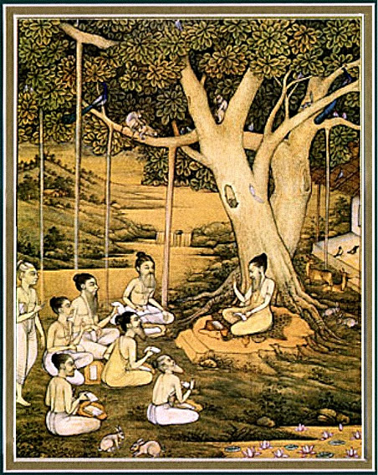
Srimad bhagavataM 1.9.23 – 33
The Art of dying

Slide 2
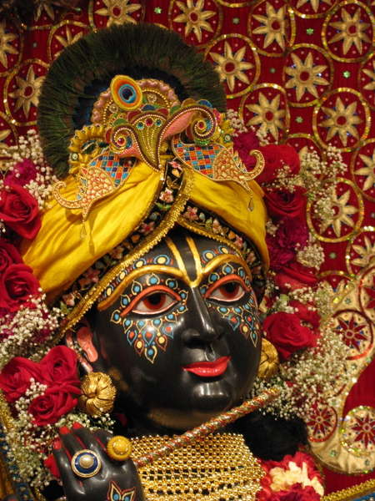
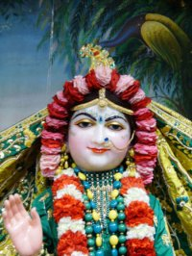
SB 1.2.4 narayanam namaskrtyam naram caiva narottamam devim sarasvatim vyasam tato jayam udirayet
Before reciting this Srimad Bhagavatam, which is the
very means of conquest, one should offer respectful
obeisances unto the Personality of Godhead, Narayana,
unto Nara - Narayana Rsi, the supermost human being,
unto mother Sarasvati, the goddess of learning, and unto
Srila Vyasadeva, the author.

Slide 3
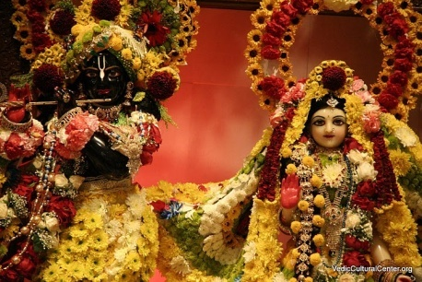
nasta-prayesy abhadresu nityaḿ bhagavata-sevaya bhagavaty uttama-sloke bhaktir bhavati naisthiki
SB 1.2.18
By regular attendance in classes on the Bhagavatam
and by rendering of service to the pure devotee, all
that is troublesome to the heart is almost completely
destroyed, and loving service unto the Personality of
Godhead, who is praised with transcendental songs, is
established as an irrevocable fact.

Slide 4
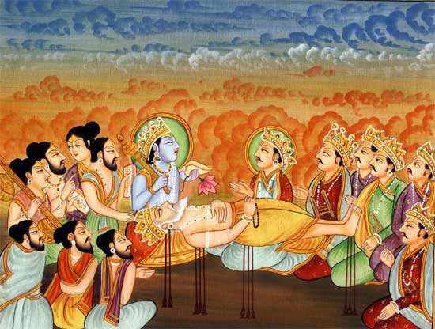
So far …

Slide 5
OUTLINE
1.9.23 – 24 Continued description of the lord
1.9.25 – 28 Instructions on how to rule
1.9.29 – 31 Preparing to leave
1.9.32 … Final prayers

Slide 6
SB 1.9.23
bhaktyäveçya mano yasmin
väcä yan-näma kértayan
tyajan kalevaraà yogé
mucyate käma-karmabhiù
The Personality of Godhead, who appears in the mind of
the devotee by attentive devotion and meditation and by
chanting of the holy name, releases the devotee from the
bondage of fruitive activities at the time of his quitting
the material body.

Slide 7
1.9.23 Qualifications to go BTG
Definition of a Yogi
Bhakti-Yogi
- 24 hours in service of the Lord
- Whole attention on the Lord
- Top-most yogi (BG 6.47)
Results of such practice
- Concentrate his mind upon Lord with perfect consciousness.
- Chants His holy name before quitting his body
- Transferred to eternal planets
“In material existence a living being has to endure the material conditions of threefold miseries, life after life, according to his fruitive work. Such material life is produced by material desires only. Devotional service to the Lord does not kill the natural desires of the living being, but they are applied in the right cause of devotional service. This qualifies the desire to be transferred to the spiritual sky.”
Notes:
1.

Slide 8
SB 1.9.24
sa deva-devo bhagavän pratékñatäà
kalevaraà yävad idaà hinomy aham
prasanna-häsäruëa-locanollasan-
mukhämbujo dhyäna-pathaç catur-bhujaù
May my Lord, who is four-handed and whose beautifully
decorated lotus face, with eyes as red as the rising sun, is
smiling, kindly await me at that moment when I quit this
material body.

Slide 9
1.9.24 – Bhishmadeva’s intent
Four-handed feature of the Lord
An Humble submission
Purification
As long as I am in this body
“A pure devotee is never very anxious to go back to the kingdom of God. He entirely depends on the good will of the Lord. He is equally satisfied even if the Lord desires him to go to hell. The only desire that a pure devotee entertains is that he may always be in rapt attention with thinking of the lotus feet of the Lord, regardless. Bhéñmadeva wanted this much only: that his mind be absorbed in thinking of the Lord and that he pass away thus. That is the highest ambition of a pure devotee.”

Slide 10
SB 1.9.25
süta uväca
yudhiñöhiras tad äkarëya
çayänaà çara-païjare
apåcchad vividhän dharmän
åñéëäà cänuçåëvatäm
Süta Gosvämé said: Mahäräja Yudhiñöhira, after hearing
Bhéñmadeva speak in that appealing tone, asked him, in
the presence of all the great åñis, about the essential
principles of various religious duties.

Slide 11
1.9.25 – Lord’s purpose
Devotee superior to great sages
Pure devotees sound in body and mind always
Yudhisthira maharaja’s preference
Submission to superiors
“This is all due to the arrangement of the great wheel-carrier Lord Çré Kåñëa, who establishes the glories of His devotee. The father likes to see the son become more famous than himself. The Lord declares very emphatically that worship of His devotee is more valuable than the worship of the Lord Himself.”

Slide 12
SB 1.9.26
puruña-sva-bhäva-vihitän
yathä-varëaà yathäçramam
vairägya-rägopädhibhyäm
ämnätobhaya-lakñaëän
At Mahäräja Yudhiñöhira's inquiry, Bhéñmadeva first
defined all the classifications of castes and orders of life
in terms of the individual's qualifications. Then he
systematically, in twofold divisions, described
counteraction by detachment and interaction by
attachment.

Slide 13
1.9.26 – Details of Varnashrama dharma
Qualifications to be civilized
1. Not to become angry | 2. Not to lie
3. Distribute wealth equally | 4. To forgive
5. To have legit children | 6. Pure mind & Healthy body
7. No enmity towards anyone | 8. Be simple
9. Support servants | 10. Chant rounds
“The conception of four castes and four orders of life, as planned by the Lord Himself (Bg. 4.13), is to accelerate transcendental qualities of the individual person so that he may gradually realize his spiritual identity and thus act accordingly to get free from material bondage, or conditional life…The varëäçrama-dharma is prescribed for the civilized human being just to train him to successfully terminate human life.”

Slide 14
1.9.26 – Duties of the four castes
Brahmanas (intelligent men)
- Sense control
- Study of vedic literature – esp SB and BG.
Ksatriyas (administrative class)
- Give charity and never receive charity
- Well-versed in Shastras.
- Never pretend to be non-violent.
- Never return from battle without being hurt.
Vaisyas (mercantile community)
- Cow protection
- Agriculture and distribution of foodstuff.
- Charity
Sudras
- Render service to 3 higher castes
- Should not bank money
- Should not leave one’s master.

Slide 15
1.9.26 – Duties of the four ashramas
Training ground
Perform sacrifices
Servants of other ashramas
Brahmacarya
Attached
Detached
Grhastha
Sanyasa
Give charity
Family life with detachment
Support other ashramas
Live on charity only
Keep body and soul together
Penances and austerities
“The varëas are, so to speak, classifications of different occupations, and äçrama-dharma is gradual progress on the path of self-realization. Both are interrelated, and one is dependent on the other. The main purpose of äçrama-dharma is to awaken knowledge and detachment..The whole system of äçrama-dharma is a means to detachment.”

Slide 16
SB 1.9.27
däna-dharmän räja-dharmän
mokña-dharmän vibhägaçaù
stré-dharmän bhagavad-dharmän
samäsa-vyäsa-yogataù
He then explained, by divisions, acts of charity, the
pragmatic activities of a king and activities for salvation.
Then he described the duties of women and devotees,
both briefly and extensively.

Slide 17
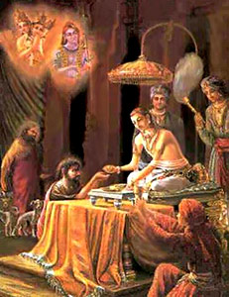
1.9.27 – Acts of charity & Duties of a King
Acts of charity
- 50% of income in service of the Lord
- Result: Purification & Eligibility for transcendental loving service.
Duties of a King
- Lead subjects toward salvation
- Trained to become munificent.
- Alert to kill thieves and dacoits
- Not lazy and sensuous
- Special protection to illiterates,
helpless & widows of the state.
- Reserved energy is properly utilized.
- Defense measures to protect against attacks.
- Has right to take ¼ of the citizen’s property.

Slide 18
1.9.27 – Acts of salvation
To achieve freedom from | One should
Anger | Learn to forgive
Unlawful desires | Not make plans
Sleep | Practice spiritual culture
Lust & Avarice | Practice tolerance
Disturbance of diseases | Have regulated diets
False hopes | Self-control
Bankruptcy | Avoid undesirable assoc
Control of hunger | Practice yoga
Worldliness | Knowledge of impermanence
Dizziness | Rising up
False arguments | Factual ascertainment
Talkativeness | Gravity and Silence
Fearfulness | Prowess
Achieve perfect knowledge | Self-cultivation

Slide 19
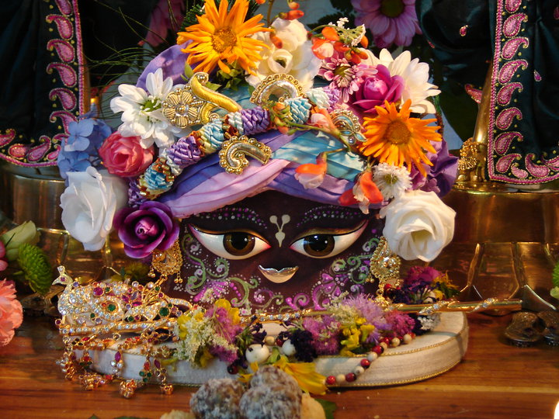
1.9.27 – Duties of women and devotees
“As far as the women class are concerned, they are accepted as a power of inspiration for men. As such, women are more powerful than men. Mighty Julius Caesar was controlled by a Cleopatra. Such powerful women are controlled by shyness. Therefore, shyness is important for women. Once this control valve is loosened, women can create havoc in society by adultery.”
Process to please the Lord
- Deity-centered life
- 5 limbs of devotional service

Slide 20
SB 1.9.28
dharmärtha-käma-mokñäàç ca
sahopäyän yathä mune
nänäkhyänetihäseñu
varëayäm äsa tattvavit
Then he described the occupational duties of different
orders and statuses of life, citing instances from history,
for he was himself well acquainted with the truth.
Notes:
-> Devotees should quote vedic lit to make it authoritative
-> Puranas
- Not in chronological order
- Diff universes and planets
- Factual historical narrations
- Need to take instructive lessons from such incidents.

Slide 21
SB 1.9.29
dharmaà pravadatas tasya
sa kälaù pratyupasthitaù
yo yoginaç chanda-måtyor
väïchitas tüttaräyaëaù
While Bhéñmadeva was describing occupational duties,
the sun's course ran into the northern hemisphere. This
period is desired by mystics who die at their will.

Slide 22
1.9.29 – Perfection of yoga
“Perfection of yoga means attainment of such supermental states as to be able to leave the material body as desired. Yogés can also reach any planet within no time without a material vehicle. The yogés can reach the highest planetary system within a very short time, and this is impossible for the materialist..This is a different science, and Bhéñmadeva knew well how to utilize it. He was just waiting for the suitable moment to quit his material body, and the golden opportunity arrived when he was instructing his noble grandsons, the Päëòavas. He thus prepared himself to quit his body before the exalted Lord Çré Kåñëa, the pious Päëòavas and the great sages headed by Bhagavän Vyäsa, etc., all great souls.”

Slide 23
SB 1.9.30
tadopasaàhåtya giraù sahasraëér
vimukta-saìgaà mana ädi-püruñe
kåñëe lasat-péta-paöe catur-bhuje
puraù sthite 'mélita-dåg vyadhärayat
Thereupon that man who spoke on different subjects with
thousands of meanings and who fought on thousands of
battlefields and protected thousands of men, stopped
speaking and, being completely freed from all bondage,
withdrew his mind from everything else and fixed his
wide-open eyes upon the original Personality of
Godhead, Çré Kåñëa, who stood before him, four-handed,
dressed in yellow garments that glittered and shined.

Slide 24
1.9.30 – Lord’s grace
“Çré Bhéñmadeva attained the perfection of quitting his body at will and was fortunate enough to have Lord Kåñëa, the object of his attention, personally present at the time of death. He therefore fixed his open eyes upon Him. He wanted to see Çré Kåñëa for a long time out of his spontaneous love for Him. Because he was a pure devotee, he had very little to do with the detailed performance of yogic principles. Simple bhakti-yoga is enough to bring about perfection. Therefore, the ardent desire of Bhéñmadeva was to see the person of Lord Kåñëa, the most lovable object, and by the grace of the Lord, Çré Bhéñmadeva had this opportunity at the last stage of his breathing.”
Notes:
SP quotes 8.5 – 15 in the purport.
Subject matter of dying man becomes beginning of next life – old man akbar girl story
Bhishmadeva was more fortunate than Arjuna
Lord shows the form devotee desires most – Hanuman, Garuda, Krsna and Rama story
Observations:
- He is seeing His Lord and peacefully leaving the world
Implies -> Surity of spiritual realm and eternal existence of the Lord

Slide 25
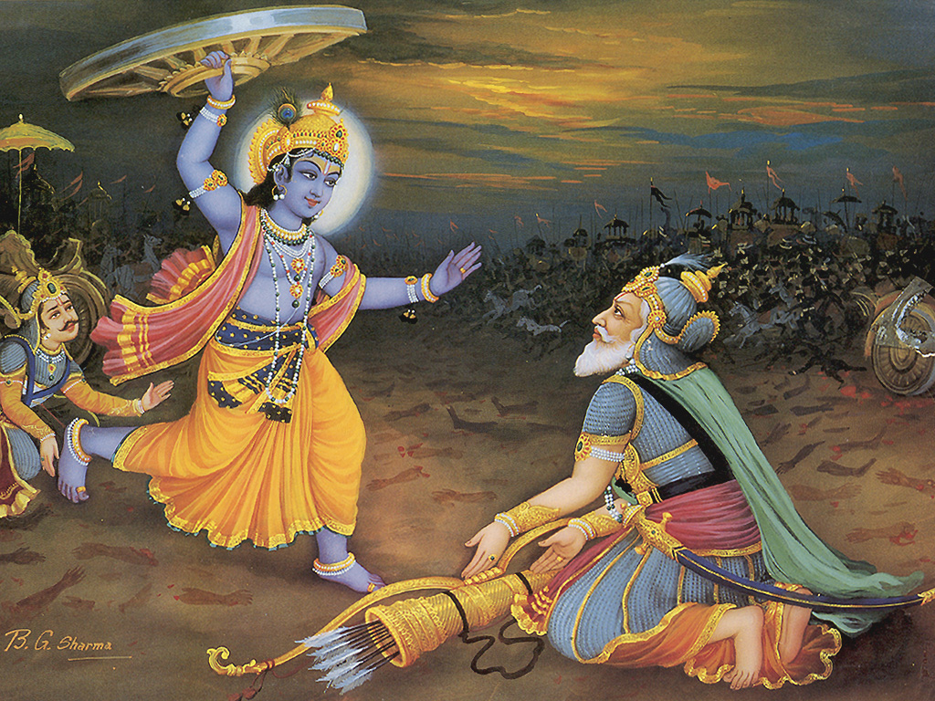
Lord’s reciprocation
Notes:
SP quotes 8.5 – 15 in the purport.
Subject matter of dying man becomes beginning of next life – old man akbar girl story
Bhishmadeva was more fortunate than Arjuna
Lord shows the form devotee desires most – Hanuman, Garuda, Krsna and Rama story
Observations:
- He is seeing His Lord and peacefully leaving the world
Implies -> Surity of spiritual realm and eternal existence of the Lord

Slide 26
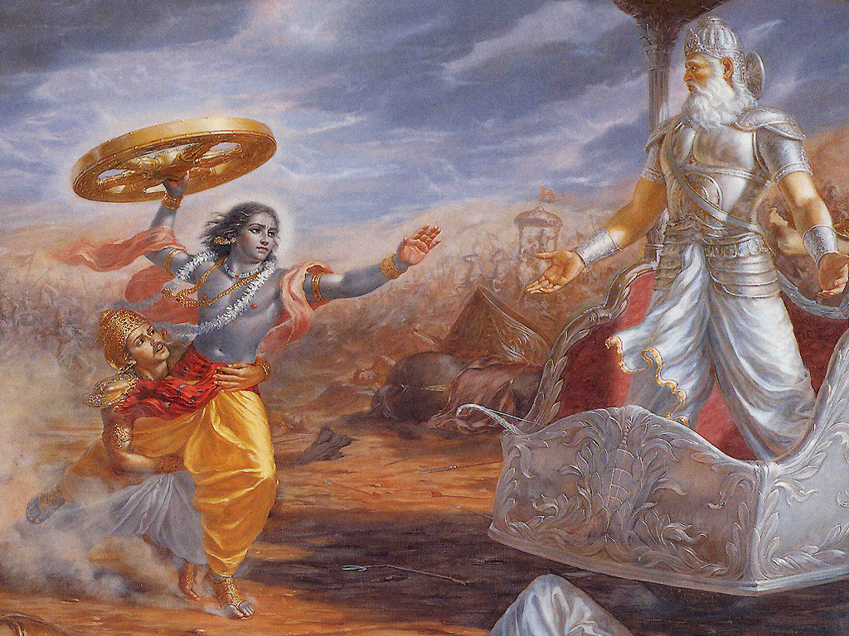
Lord’s reciprocation
Notes:
SP quotes 8.5 – 15 in the purport.
Subject matter of dying man becomes beginning of next life – old man akbar girl story
Bhishmadeva was more fortunate than Arjuna
Lord shows the form devotee desires most – Hanuman, Garuda, Krsna and Rama story
Observations:
- He is seeing His Lord and peacefully leaving the world
Implies -> Surity of spiritual realm and eternal existence of the Lord

Slide 27
SB 1.9.31
viçuddhayä dhäraëayä hatäçubhas
tad-ékñayaiväçu gatä-yudha-çramaù
nivåtta-sarvendriya-våtti-vibhramas
tuñöäva janyaà visåjaï janärdanam
By pure meditation, looking at Lord Çré Kåñëa, he at once
was freed from all material inauspiciousness and was
relieved of all bodily pains caused by the arrow wounds.
Thus all the external activities of his senses at once
stopped, and he prayed transcendentally to the controller
of all living beings while quitting his material body.

Slide 28
1.9.31 – The process of K.C
“The soul is originally pure and so also the senses. By material contamination the senses assume the role of imperfection and impurity. By revival of contact with the Supreme Pure, Lord Kåñëa, the senses again become freed from material contaminations. Bhéñmadeva attained all these transcendental conditions prior to his leaving the material body because of presence of the Lord. The Lord is the controller and benefactor of all living beings. That is the verdict of all Vedas. He is the supreme eternity and living entity amongst all the eternal living beings.* And He alone provides all necessities for all kinds of living beings. Thus He provided all facilities to fulfill the transcendental desires of His great devotee Çré Bhéñmadeva, who began to pray as follows.”

Slide 29
SB 1.9.32 - çré-bhéñma uväca
iti matir upakalpitä vitåñëä
bhagavati sätvata-puìgave vibhümni
sva-sukham upagate kvacid vihartuà
prakåtim upeyuñi yad-bhava-pravähaù
Bhéñmadeva said: Let me now invest my thinking, feeling
and willing, which were so long engaged in different
subjects and occupational duties, in the all-powerful Lord
Çré Kåñëa. He is always self-satisfied, but sometimes,
being the leader of the devotees, He enjoys
transcendental pleasure by descending on the material
world, although from Him only the material world is
created.

Slide 30
1.9.32 – The Leader of pure devotees
Diverting thinking, feeling and willing
Satvata pungave
Original Narayana
Vibhu
Lord as a Leader
Devotees
Non-devotees
- Directs only for going BTG
- Above mundane good/bad
(Progressive path of transcendence)
- No instructions to go BTG
(Overseer and Permitter only)
- Awards good/bad according to Karma
Notes:
HH BRS maharaja’s question to HH RNS in “We are not indras” in 1993
- Lord will not instruct non-devotees because they don’t want it.

Slide 31
SB 1.9.33
tri-bhuvana-kamanaà tamäla-varëaà
ravi-kara-gaura-varämbaraà dadhäne
vapur alaka-kulävåtänanäbjaà
vijaya-sakhe ratir astu me 'navadyä
Çré Kåñëa is the intimate friend of Arjuna. He has
appeared on this earth in His transcendental body, which
resembles the bluish color of the tamäla tree. His body
attracts everyone in the three planetary systems [upper,
middle and lower]. May His glittering yellow dress and
His lotus face, covered with paintings of sandalwood
pulp, be the object of my attraction, and may I not desire
fruitive results.

Slide 32
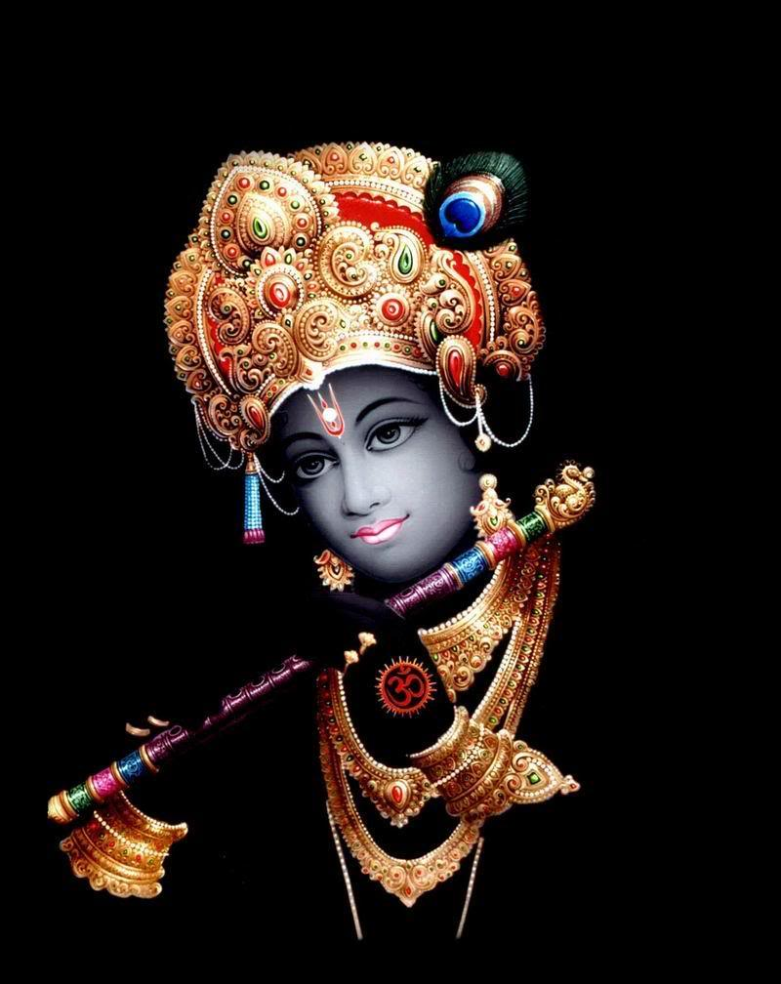
1.9.33 - All Attractive
tri-bhuvana-kamanaà
vijaya-sakhe
- Friend of the conqueror
- Admiring Arjuna
- Lord’s pleasure
ravi-kara-gaura-varämbaraà

Slide 33
Summary
Qualifications to go BTG
Duties of varnas, ashramas,
women, devotees etc.
Preparation for the final
moment
Sincere and attentive practice of sadhana bhakti following the mahajanas qualifies us for transcendental loving service of the Lord, who is most attractive of the three planetary systems.

Slide 34
References
HH Romapada maharaja’s lectures on this section.
HH Radhanath maharaja’s classes on DesireTree.
HG Bhurijana prabhu’s – Unveiling His Lotus Feet.
Srila Prabhupada’s purports.

Slide 35
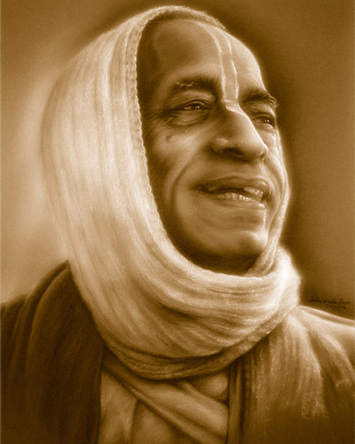
Thank you very much
All glories to Srila Prabhupada!

